Slide 1

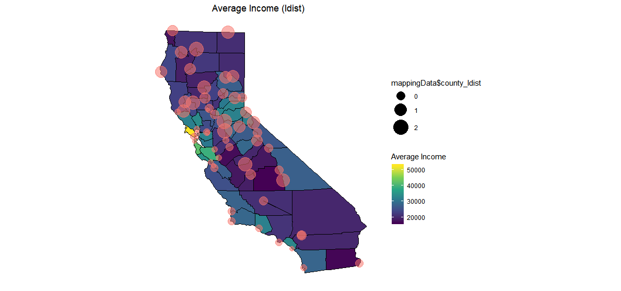
IST 687 Project
01
California Protected Land Analysis
Objective
The goal of this project was to analyze data from California gathered in 2010 to see if there is any disparity in access of protected land (also known as “green space”, such as parks). The data contained information on median income, average income, racial breakdown, educational breakdown, voting information and distance from the center of a tract (subsection of a county) to the center of the nearest protected land area.
Lauren Lawless
Dan Kochman
David Yamin

Slide 2

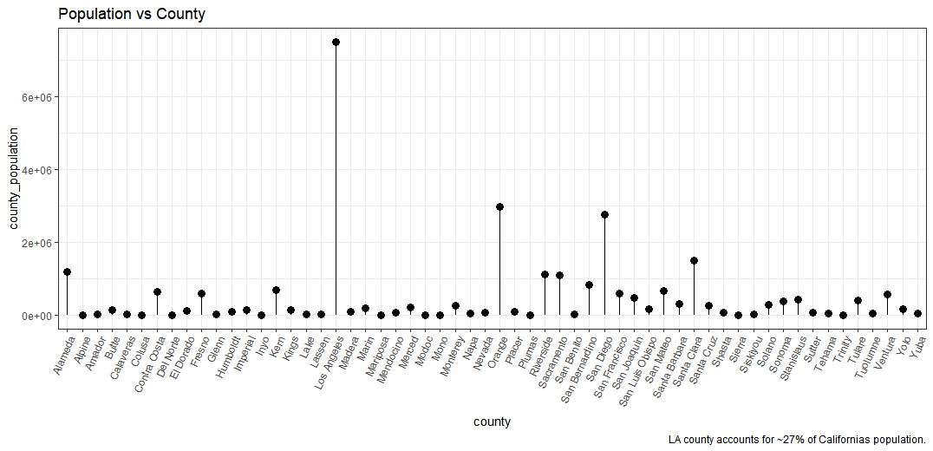
02
Population Distribution
To get a better understanding of California’s population, we should first look at where people live. By a substantial margin, there is a disproportionate number of people living in the southwest area of the state, with Los Angeles county accounting for roughly 27% of California’s total population. With such a concentration of people in a small area, we will see several tie-ins to urban populations and how it affects wealth and protected land access.

Slide 3

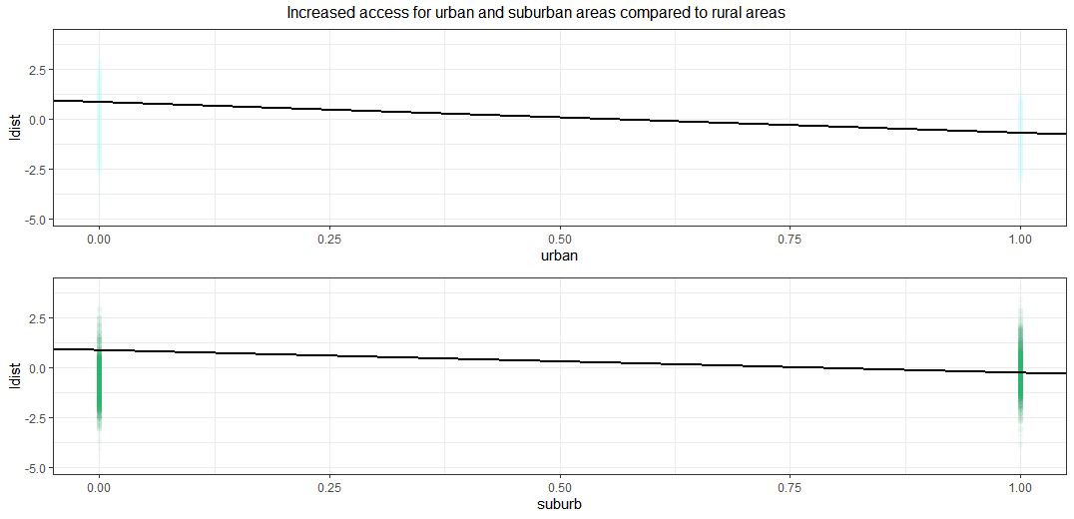
03
Urban and Suburban Access
Citizens living in urban and suburban areas have decreased distance, and therefore increased access, to protected land compared to their more rural counterparts. In fact, we found that living in the suburbs garnered a 67.75% increase in access while living in an urban area provided an increase of 78.48% access to protected land.

Slide 4

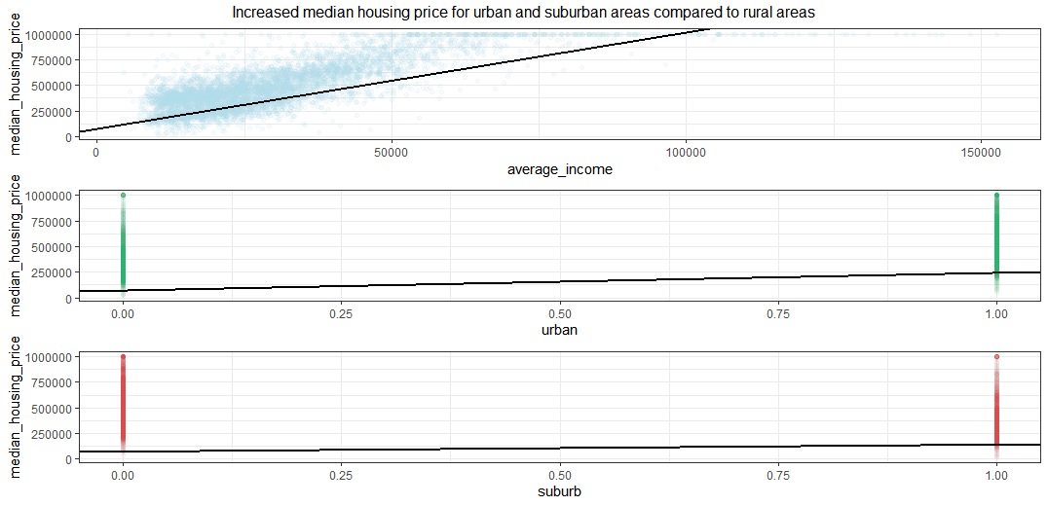
04
Income and Housing Price
Not surprisingly, this model showed that average income and urban locations seem to be the primary drivers of housing prices in California; though suburban housing prices are also on the higher end compared to rural houses. It should be noted that housing prices were capped at 1 million dollars. This means the top graph could (and likely would) show a larger dispersion of observations than what is being shown here.

Slide 5

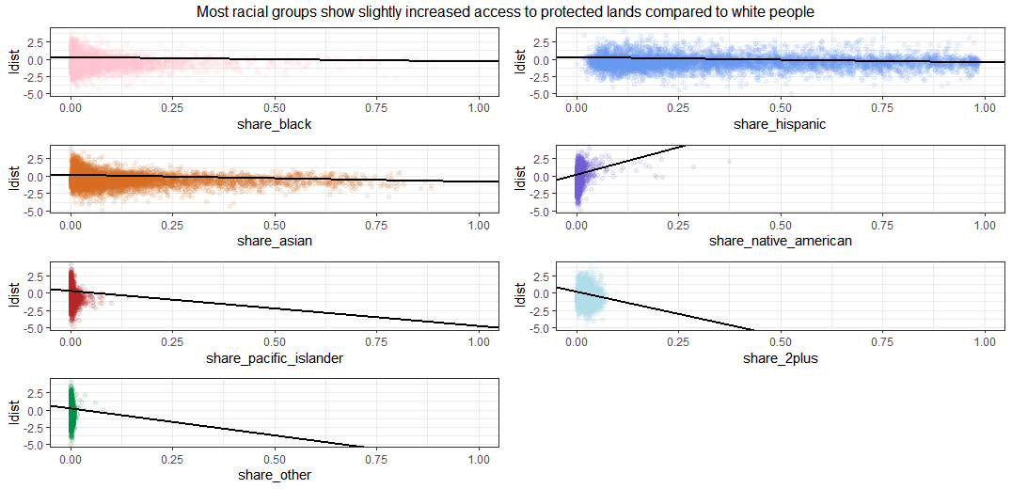
05
Race and Access
Here we see that most racial groups have slightly increased access to protected land compared to white populations. Of notable except is that of Native American populations which see highly decreased access (increased distance) due to native land not being included in the group of designated protected lands.

Slide 6

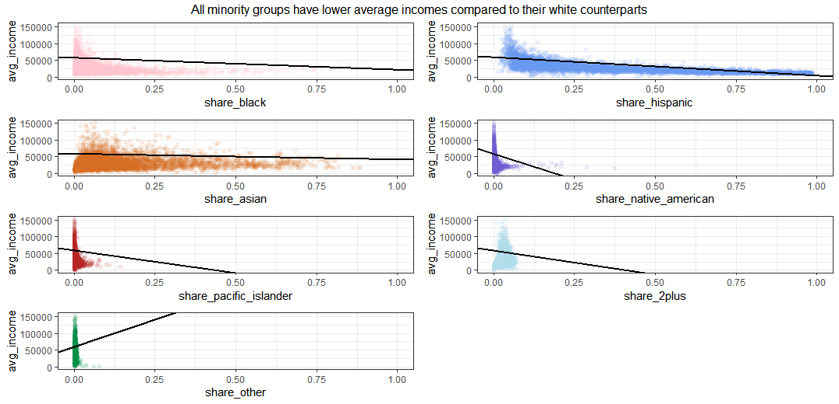
06
Race and Income
Sadly, aside from those who identified as a racial group that wasn’t specifically stated in the survey (i.e. “other”), all racial groups in California are shown to be making less income on average than their white counterparts.

Slide 7

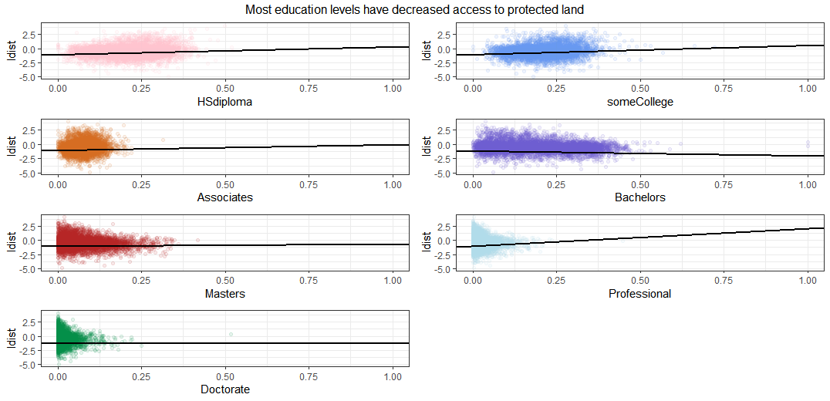
07
Education and Access
Most education levels show a slight increase in distance (decrease in access) to protected lands with the exceptions being those with Professional degrees (Lawyers, Physicians, etc.) who see a marked decrease in access; while those holding a Bachelors degree have a slight increase in access.

Slide 8

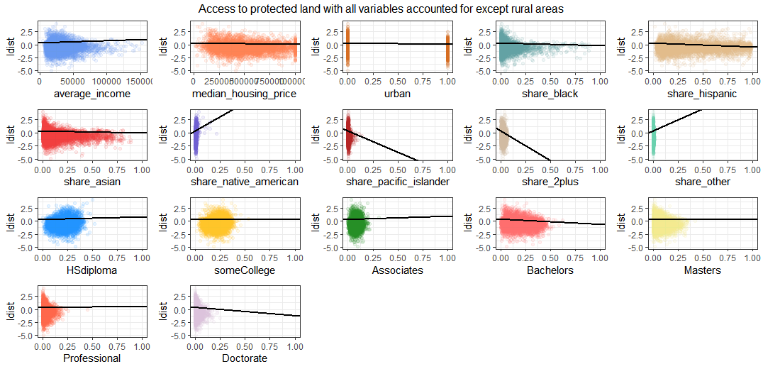
08
Location, Location, Location
Looking purely at non-rural areas (urban and suburban combined), we see that a combination of median housing price and average income, when taken with appropriate magnitudes, would oftentimes indicate increased access for higher-income communities (overall negative effect on distance) over lower-income communities. We also see mostly negative coefficients (decreased distance and thus increased access) for more educated communities, compared to mostly positive coefficients (increased distance and thus decreased access) for less educated communities. Therefore, while we cannot establish racial inequality in access to protected lands in urban and suburban areas, we can reasonably state that there is income and education-related inequality.

Slide 9

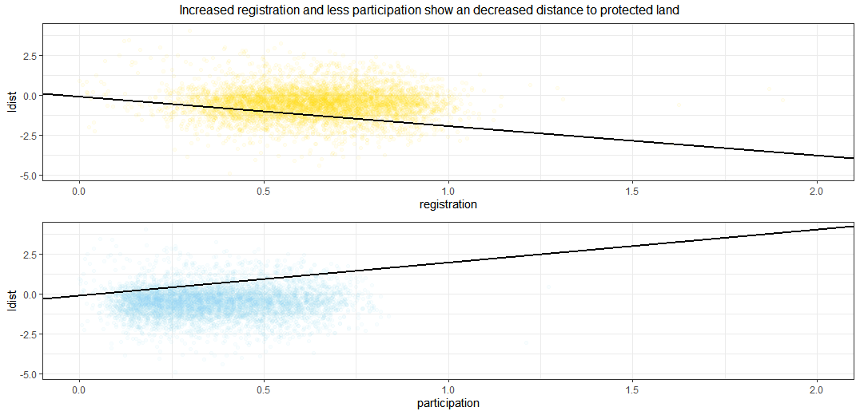
09
So now what?
This model shows that higher voter registration and lower voter participation are associated with increased access to protected land areas. Speculatively, this may indicate that voter engagement (interacting with local officials and politics in ways other than voting) may impact local protected areas more so than just voter participation.

Slide 10

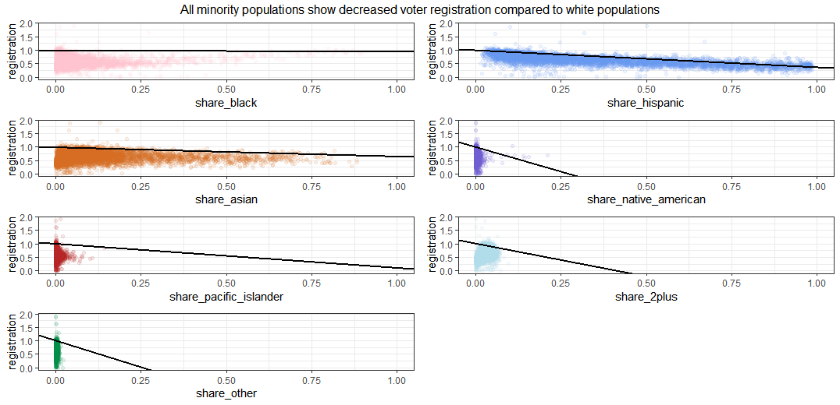
10
Registration and Race
All minority populations show decreased voter registration compared to white populations in non-rural counties in California; especially Native Americans, multiracial and other population groups.

Slide 11

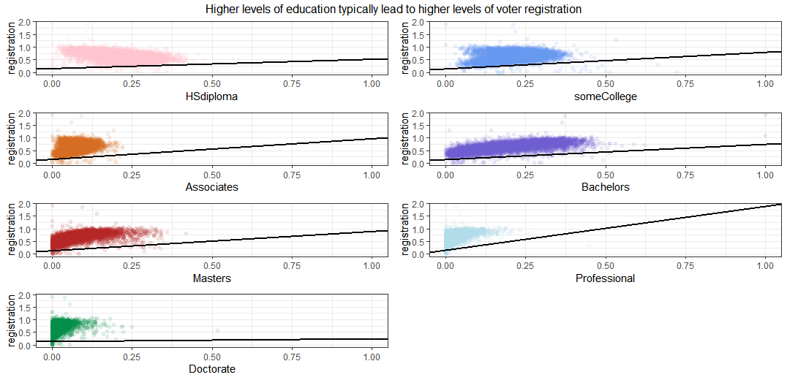
11
Registration and Education
As education level increases, so does voter registration, except for communities with higher proportions of doctorates, where we see registration levels much lower than all other education levels.

Slide 12

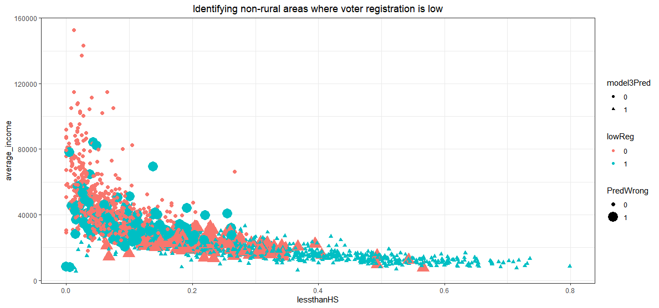
12
Where to do the most good
Using ksvm, we can use the data we have available to identify non-rural census tracts where voter engagement (registration) is low and efforts to improve it would be most beneficial to the community by engaging larger proportions of the population in local politics, thereby eventually (and hopefully) increasing access to protected lands.

Slide 13
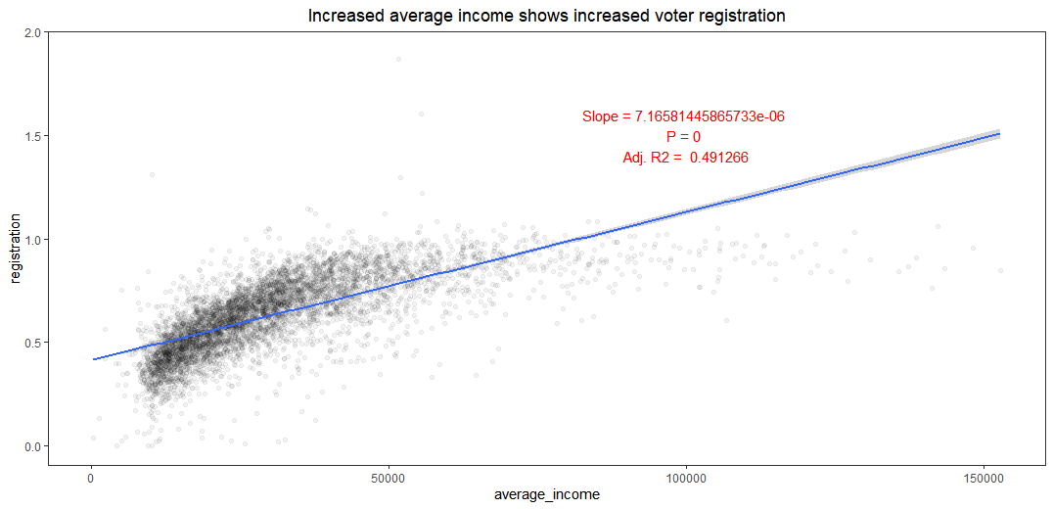

Income and voter registration
Voter registration, a significant indicator of access to protected land areas by census tract, is reduced in:
Certain communities of color
Less educated communities
Lower income communities
Without direct intervention in designating protected land areas in disadvantaged communities, we suggest a focus on increasing voter registration in those communities as a gateway for increased voter engagement.
That being said, direct intervention may be necessary, as disadvantaged communities often have more difficulty engaging with politics (lack of flexible working hours, inaccessibility to engagement opportunities).
13

